Slide 1
Multi-Agent Reinforcement Learning for DeepRacer Multi-Car Racing
Kaiqing Zhang
Amazon AI Labs Intern
Mentor: Sahika Genc
2019.08.07

Slide 2
Overview of My Contributions
 | Stage 1: Object-Avoidance | Stage 2: Racing with Fixed-Policy Opponent | Stage 3: Multi-Car Racing | Longer Term
Science | Design reward function |  | Formulate Robust MARL motivated from DeepRacer | Organize DeepRacer MARL reading group
 | Warm start to improve sample-efficiency |  | Develop theory for Robust MARL | Present and brainstorm ideas on MARL
Engineering | Real track test | Build MADDPG [Lowe ’17] with one learner car in Coach | TO DO: Test algorithms | Build MARL framework in Coach codebase
Documentation | Report & Quip doc |  | Paper draft | Idea Bank for DeepRacer

Slide 3
Outline
Multi-Agent RL & Multi-Car Racing
New problem: Robust MARL
Algorithms & Theoretical Results
MARL for Coach
Other contributions

Slide 4
Outline
Multi-Agent RL & Multi-Car Racing
New problem: Robust MARL
Algorithms & Theoretical Results
MARL for Coach
Other contributions

Slide 5
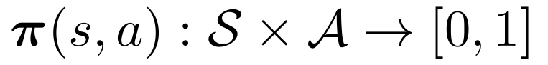
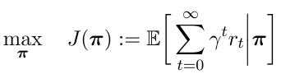
Reinforcement Learning (RL)
Reinforcement Learning: solving Markov decision processes/optimal control problem without knowing the model
(Stationary) policy:
Goal: maximize accumulated/time-average reward
Algorithms:
Critic-only/value-based: e.g., Q-learning, SARSA, DQN, DDQN
Actor-only/policy-based: e.g., policy gradient, PPO, TRPO
Actor-critic enjoys both advantages
Source: Reinforcement learning Lecture Notes, David Silver, 2016

Slide 6
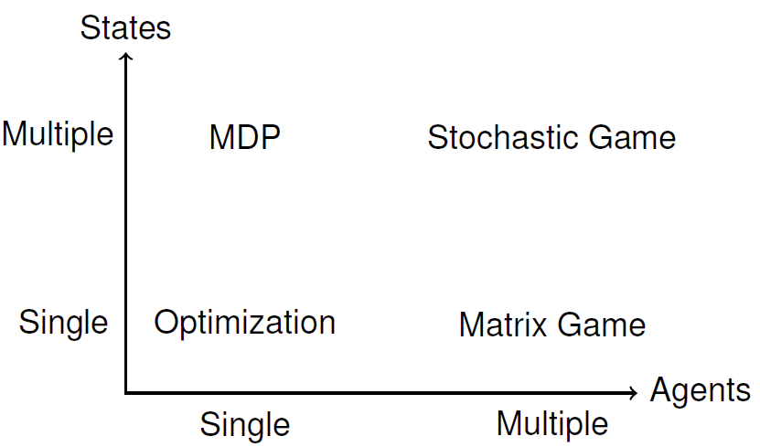
Multi-Agent RL (MARL)
Many practical applications involve multiple agents
Robotics, autonomous vehicles
Sensor networks
Video games, game of Go
Settings:
Cooperative
Mixed of the two
Algorithms:
Tabular case/linear function approximation, with convergence guarantee
Neural-nets for function approximation, mostly purely empirical
See my previous literature review slides for more details
RL
MARL
Competitive
Notes:
Note that besides SG, some other settings may also be claimed to be MARL, e.g., repeated games, extensive games.

Slide 7
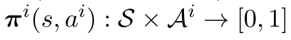
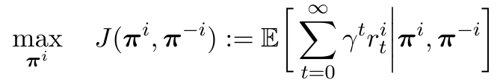
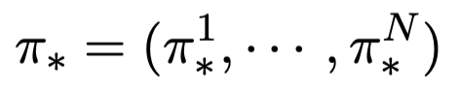
Modeling of MARL
Framework: Stochastic/Markov Games [Littman ’94]
Policy: , joint policy
Goal:
Solution concept: Nash equilibrium (NE)
Special cases: team & zero-sum
Challenges:
Non-stationarity [Tan ’93]
Curse of dimensionality: with # of agents
Learning goal [Shoham ’06]
Notes:
Non stationarity due to the interaction between both the environment and the agents
Learning goal: equilibrium? What kind of equilibrium, why Nash? What about regret minimization? Why convergence? Is non-convergent behavior always bad? Should we focus on the convergence or the payoff the agents obtain? Is the learning procedure rational for each agent? How to learn?
Sum up: what’s the problem and the associated evaluation criteria

Slide 8
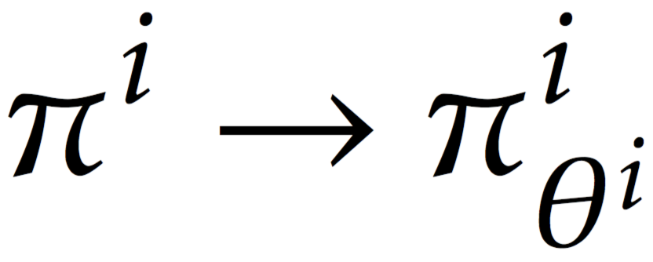
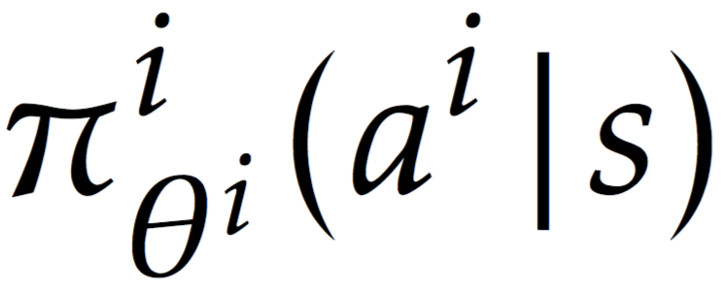
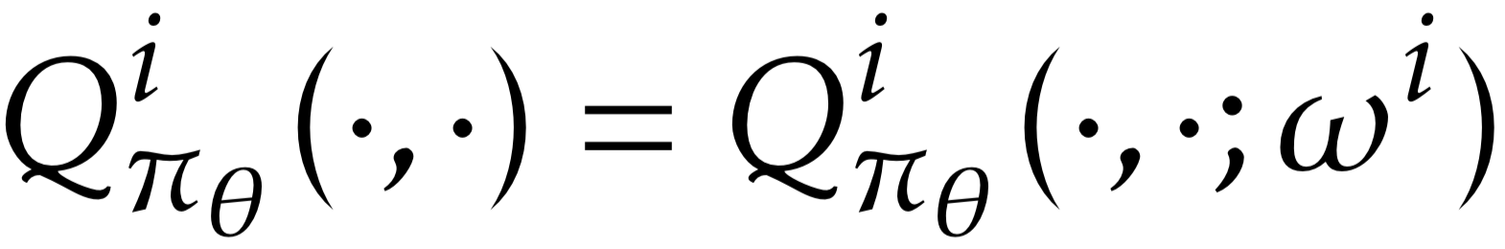
MARL Algorithms
Value-based:
Minimax-Q [Littman ’94], Nash-Q [Hu and Wellman ’00], Friend-Foe-Q [Littman ’01]
Neural networks-based: Use NN to approximate Q-function
Policy-based: parametrize
Multi-agent policy gradient:
Each agent improves following its own policy gradient
Actor-critic: additionally parametrize
[Gupta et al., ’17; Lowe et al., ’17; Srinivasan et al., ’19]

Slide 9
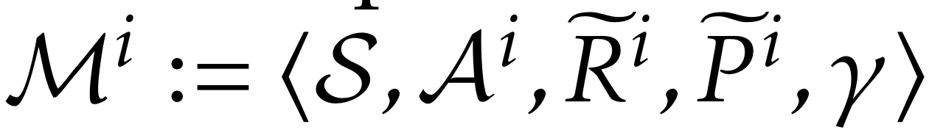
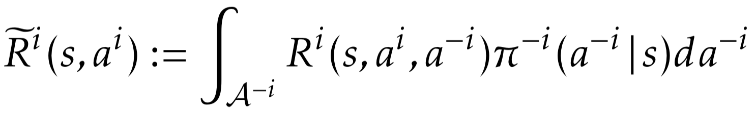
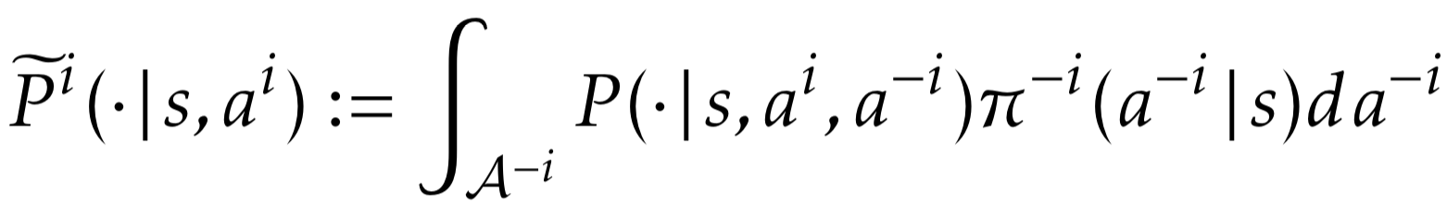
Multi-Car Racing & MARL
Stage 1: Object-avoidance
Essentially single-agent RL, with reward re-design
Single-agent RL, e.g., PPO, suffices
Stage 2: Racing with fixed-policy opponent
Minimum viable product (MVP) case
Essentially also single-agent RL, with reward re-design
Either single agent RL, or MARL with only one agent updating the policy
Stage 3: Multi-car racing
Actual MARL framework: general-sum Markov games
State-of-the-art MARL algorithms should work, e.g., MADDPG in [Lowe et al., 17’]
with
and

Slide 10
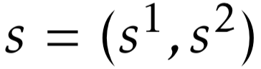
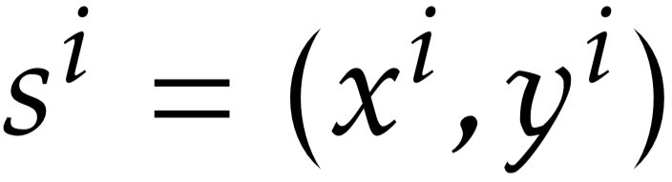
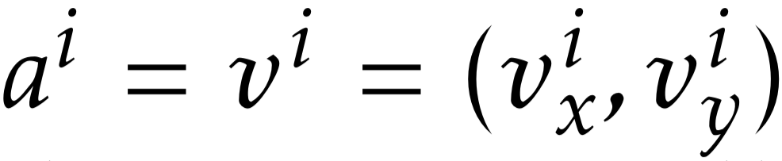
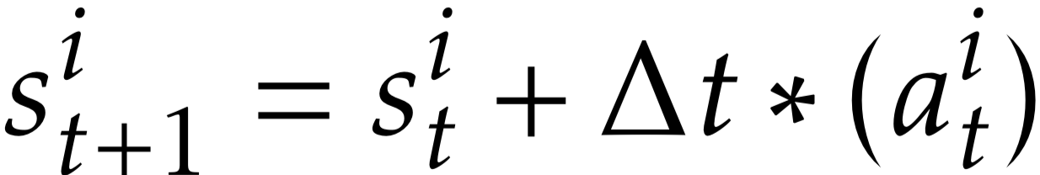
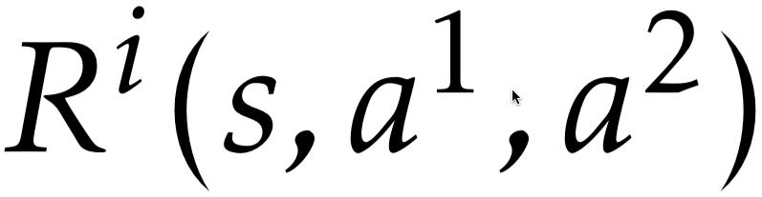
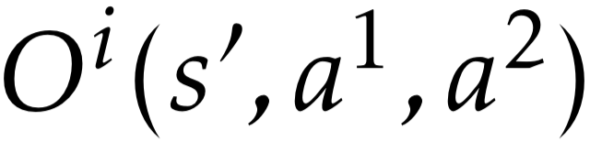
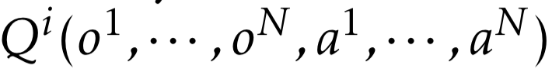
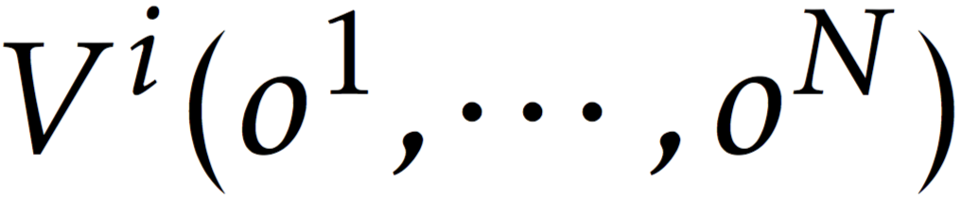
Multi-Car Racing & MARL
Modeled as a Markov game with partial observability (POMG)
State: joint position , with
Action: velocity
Transition: physical model
Reward: finish as fast as possible + avoid collision
Observation: image from on-car camera
In general, POMG is NEXP-complete in theory [Bernstein et al., ’00]
Two solutions (see report [Zhang and Genc, ’19])
God camera: partial observability to full observability (Markov game)
Optimal in theory
Existing MARL algorithms can apply
Heuristic approximation: use “joint observation” as “state”, i.e.,
and
Notes:
NEXP: nondeterministic exponential time, i.e., provably do not admit polynomial-time algorithms. This trait is not shared by the MDP problems nor the POMDP problem. any algorithm for solving either problem will most likely take doubly exponential time in the worst case.

Slide 11
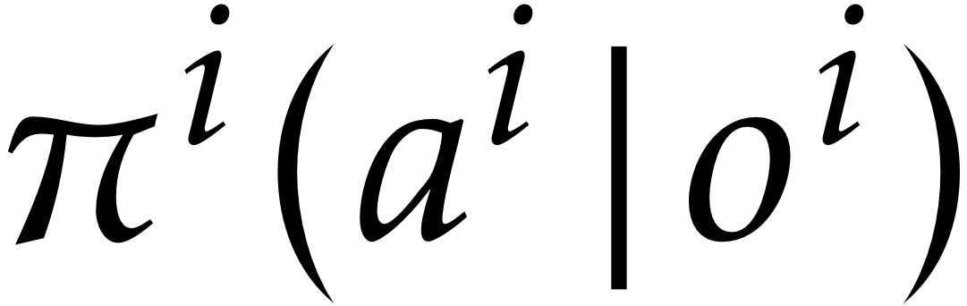
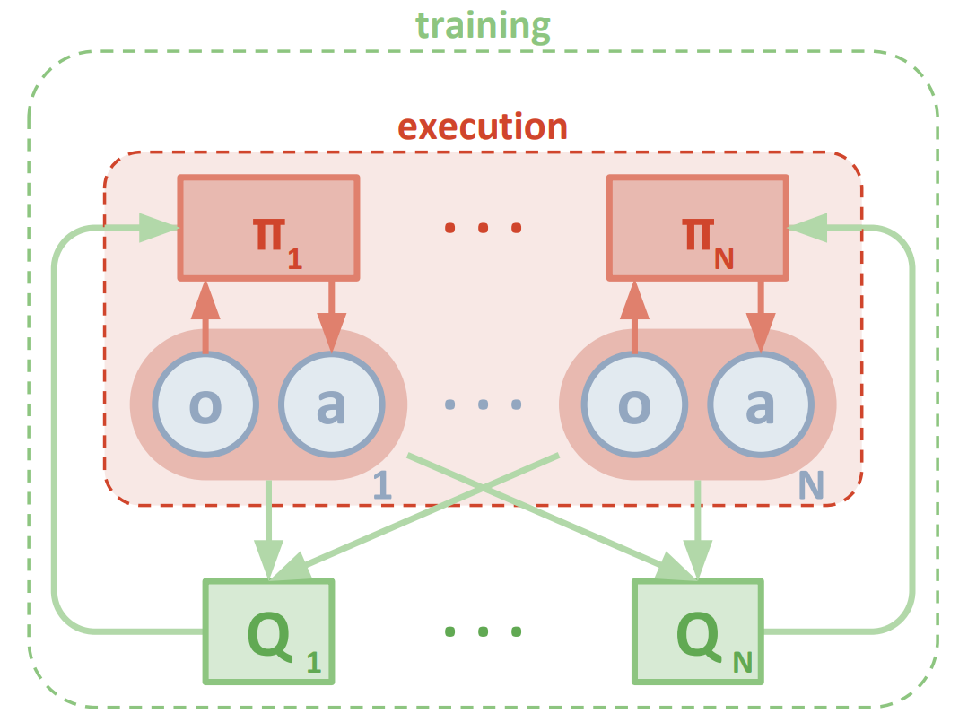
Multi-Car Racing & MARL
Algorithmic structure for Stages 2 & 3 (Idea from MADDPG [Lowe et al., ’17])
Centralized critic (in simulator) + decentralized actor (in sim2real)
Obs. and actions of other agents can be used to ease training, since
But only local observation is used for execution, since
Actor-critic, also DPG, PPO, TRPO, fit in this structure
For Stage 2: only one agent updates
“Multi-car Arena” service for DeepRacer
Multi-car racing environment with customized reward
Customer models can be submitted as a payment
Models are collected to improve the arena
Source: [Lowe et al., 2017]

Slide 12
Outline
Multi-Agent RL & Multi-Car Racing
New problem: Robust MARL
Algorithms & Theoretical Results
MARL for Coach
Other contributions

Slide 13
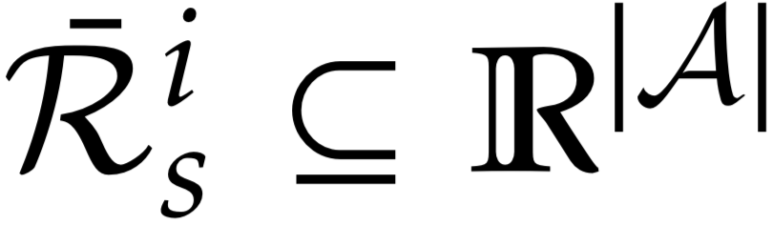
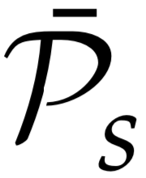
Motivation
What if different multi-car arenas use different customized rewards?
Each customer trains the Nash equilibrium policy for its agent
NE policies of different games may not constitute an equilibrium anymore
Trained policy should be robust w.r.t. this reward uncertainty
Formally, robust RL + MARL
Model: robust Markov games [Kardeş et al., ’11]
Uncertainty sets of reward functions and transitions
“Distribution-free” way to model uncertainty, as in robust optimization [Nemirovski et al., ’09]

Slide 14
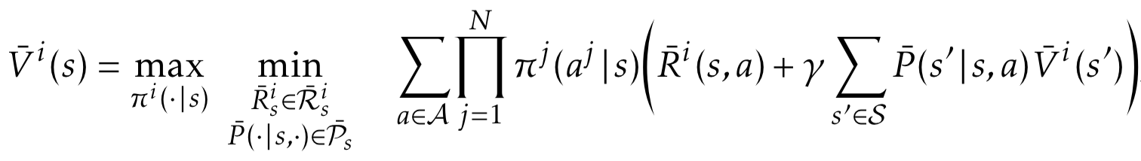
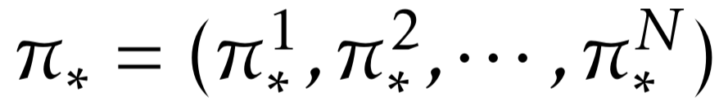
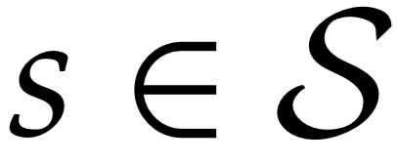
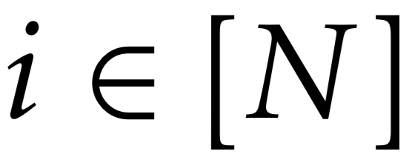
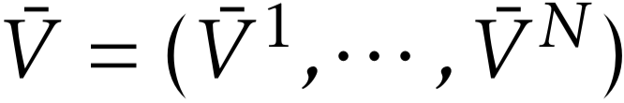
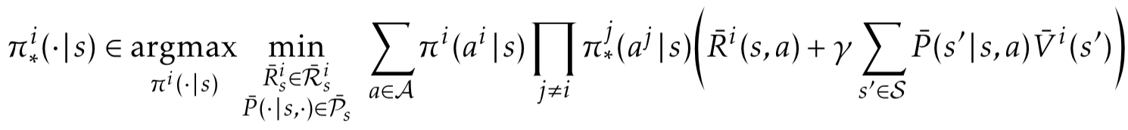
Formulation
Bellman equation
Fact: an agent plays to optimize the worst-case of “current-stage cost” + “worst-case cost from current-stage on”
Interesting view: the uncertainty is the decision made by a “nature” agent
Solution concept: robust Markov perfect Nash equilibrium (RMPNE)
Joint policy , if for any and , there exists

Slide 15
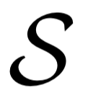
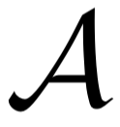
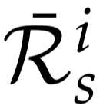
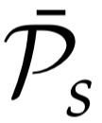
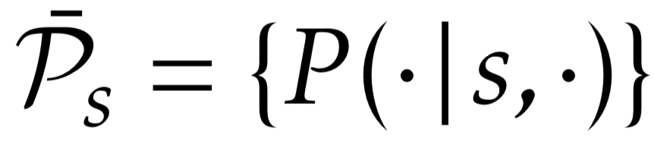
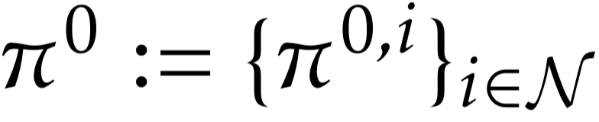
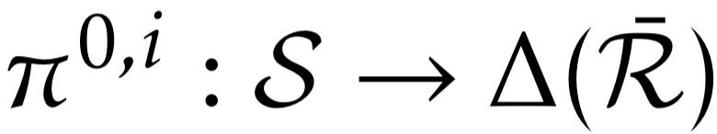
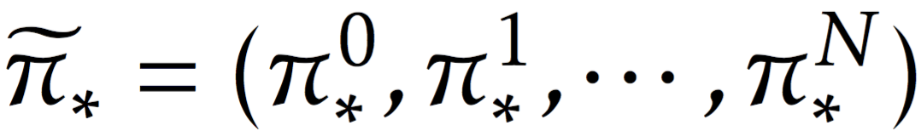
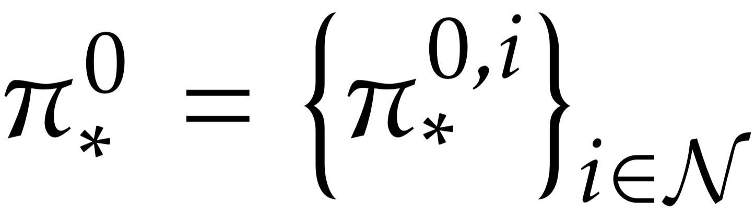
Existence of the Equilibrium
Proposition 1: with finite state action spaces and , and compact uncertain sets and , there always exists a RMPNE.
Proof based on Kakutani fixed-point theorem, following [Kardeş et al., ’11]
For DeepRacer, transition is certain, i.e., , then Bellman equation
Nature policy , with
Equivalent solution concept: RMPNE with nature (NRMPNE)
Existence of RMPNE existence of NRMPNE with deterministic

Slide 16
Outline
Multi-Agent RL & Multi-Car Racing
New problem: Robust MARL
Algorithms & Theoretical Results
MARL for Coach
Other contributions

Slide 17
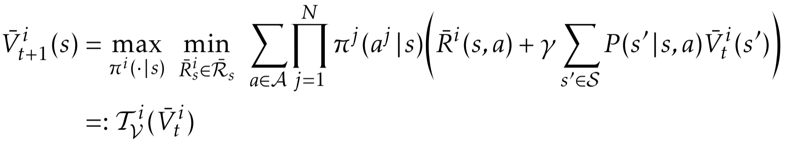
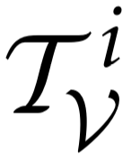
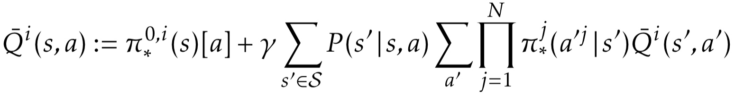
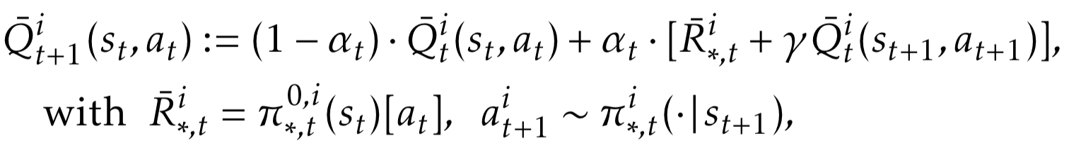
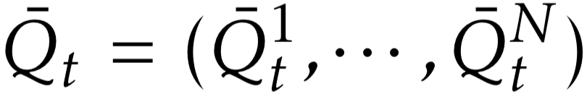
Value-based Algorithms
Known model: value iteration
Converges if is a contracting mapping
Unknown model: Q-learning
Bellman equation for Q-value:
Learning update
where and are equilibrium policies that solve stage-game

Slide 18
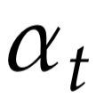
Value-based Algorithms
Theorem 2 (Informal): Under the same assumptions on the learning rate , the exploration policy, and the equilibrium-point properties as Nash-Q learning[Hu and Wellman ’00], Q-learning for robust MARL converges to the RMPNE almost surely.
Proof borrows the idea from [Hu and Wellman ’00]
However, all agents’ Q-value estimates needs to be maintained
Cannot have “decentralized execution”

Slide 19
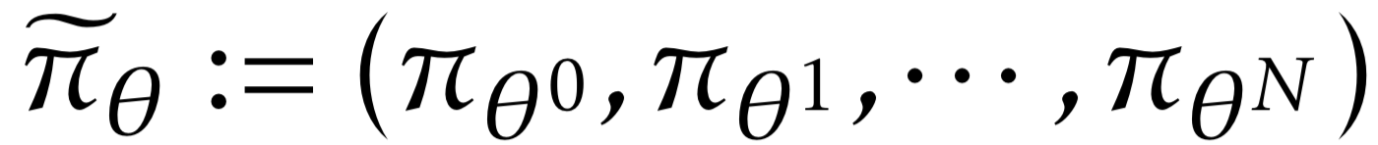
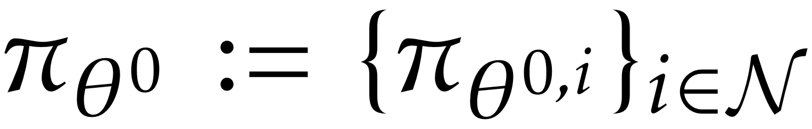
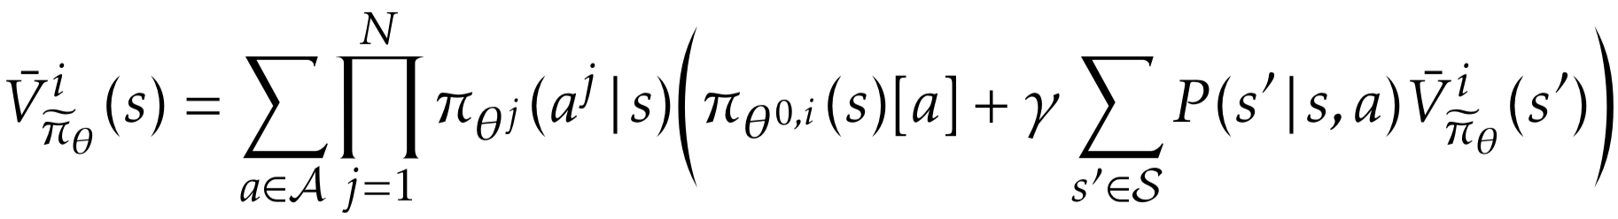
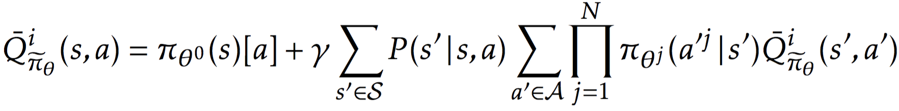
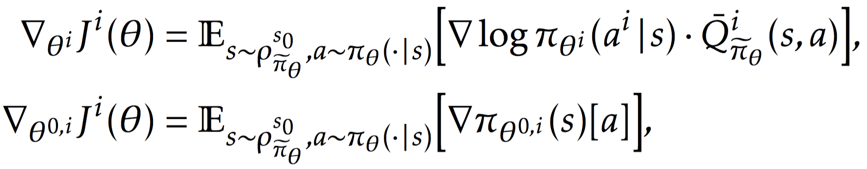
Policy-based Algorithms
Parameterize the policies , with
Value functions given
Theorem 3 [Policy Gradient Theorem for Robust MARL] The policy gradients w.r.t. each agent’s parameter have the following form:

Slide 20




Actor-Critic for Robust MARL
Also parameterize by
Two timescale online updates:
Fits in “centralized critic + decentralized actor” framework
Critic
Actor

Slide 21

Actor-Critic for Robust MARL
Pseudocode for batch version:

Slide 22
Outline
Multi-Agent RL & Multi-Car Racing
New problem: Robust MARL
Algorithms & Theoretical Results
MARL for Coach
Other contributions

Slide 23
Code Structure
Code structure in Coach RL
Modifications
Graph Manager: multiagent_step(), with joint act_n and obs_n as inputs, joint env_response_n as outputs
Agent: maddpg_agent(), with agents and agent_index as input; train_multiagent(), concatenate the observation and action to prepare batch; learn_from_batch(), update NN weights for critic using _n data, and for actor using local observation
Environment: GymVectorEnvironment.level to support graph_manager
Preset: combine everything
RL Environment
Agent (Algorithm)
Preset
Graph Manager

Slide 24
Outline
Multi-Agent RL & Multi-Car Racing
New problem: Robust MARL
Algorithms
Theoretical Results
MARL for Coach
Other contributions

Slide 25


Other Contributions
Design reward for object-avoidance and MVP case: https://quip-amazon.com/fpfoA9DUYyG1
Idea: use relative information between cars, e.g., position, velocity, heading, etc.

Slide 26



Other Contributions
Design reward for object-avoidance and MVP case: https://quip-amazon.com/fpfoA9DUYyG1
Performance improved (with Tao)
Safe_Angle = 45, 46.1% at iter. 42
Baseline with simple “bubble” reward, 51% at iter. 77
Safe_Angle = 30, 51% at iter. 51

Slide 27

Other Contributions
“Warm start” idea to improve sample efficiency
Idea: use the pretrained model from single-car racing, only need to “learn” avoiding
Performance improved (with Tao & Yunzhe)
Cold start
Warm start with “inner lane model”

Slide 28
Other Contributions
Start the MARL reading group and a reading list: https://quip-amazon.com/coenAWLl4el4
Start an “Idea bank” on RL for DeepRacer (with Sunil): https://quip-amazon.com/mSV6AnnwFpQp

Slide 29
Highlights & Conclusions
Three stages are required to achieve actual multi-car racing
Studied robust MARL for the first time, motivated from DeepRacer competition (potentially a research paper)
Centralized critic + decentralized actor can be the training framework for multi-car racing
Implemented this framework in Coach for later MARL training

Slide 30
References
M. L. Littman. “Markov games as a framework for multi-agent reinforcement learning,” In Machine learning proceedings, pages 157–163. Elsevier, 1994.
C. Boutilier. “Planning, learning and coordination in multi-agent decision processes,” In Conference on Theoretical Aspects of Rationality and Knowledge, pages 195–210, 1996.
M. L. Littman. “Friend-or-foe Q-learning in general-sum games,” In International Conference on Machine Learning, volume 1, pages 322–328, 2001.
Y. Shoham, R. Powers, and T. Grenager. “Multi-agent reinforcement learning: A critical survey,” Technical Report, 2003.
X. Wang and T. Sandholm. “Reinforcement learning to play an optimal Nash equilibrium in team Markov games,” In Advances in Neural Information Processing Systems, pages 1603–1610, 2003.
J. Hu and M.P. Wellman. “Nash Q-learning for general-sum stochastic games,” Journal of Machine Learning Research, 4(11):1039–1069, 2003.
T. Smith and R. Simmons. “Heuristic search value iteration for POMDPs,” In Proceedings of the Conference on Uncertainty in Artificial Intelligence, pages 520–527, 2004.
D. Silver and J. Veness. “Monte-Carlo planning in large POMDPs,” In Advances in Neural Information Processing Systems, pages 2164–2172, 2010.
S. Kar, J.M. Moura, and H.V. Poor. “QD-learning: A collaborative distributed strategy for multi-agent reinforcement learning through consensus + innovations,” IEEE Transactions on Signal Processing, 61(7):1848–1862, 2013.
J. Foerster, Y.M. Assael, N. Freitas, and S. Whiteson. “Learning to communicate with deep multi-agent reinforcement learning,” In Advances in Neural Information Processing Systems, pages 2137–2145, 2016.

Slide 31
References
J. Perolat, F. Strub, B. Piot, and O. Pietquin. “Learning Nash equilibrium for general-sum Markov games from batch data.,” arXiv preprint arXiv:1606.08718, 2016.
R. Lowe, Y. Wu, A. Tamar, J. Harb, P. Abbeel, and I. Mordatch. “Multi-agent actor-critic for mixed cooperative competitive environments,” arXiv preprint arXiv:1706.02275, 2017.
G. Arslan and S. Yüksel, “Decentralized Q-learning for stochastic teams and games,” IEEE Transactions on Automatic Control, vol. 62, no. 4, pp. 1545–1558, 2017.
A. Mathkar and V. S. Borkar. “Distributed reinforcement learning via gossip,” IEEE Transactions on Automatic Control , 62(3):1465–1470, 2017.
K. Zhang, Z. Yang, H. Liu, T. Zhang, and T. Başar. “Fully decentralized multi-agent reinforcement learning with networked agents,” In International Conference on Machine Learning, pages 5872–5881, 2018.
L. Lin, K. Zhang, Z. Yang, Z. Wang, T. Başar, R. Sandhu, and J. Liu. “A Communication-Efficient Multi-Agent Actor-Critic Algorithm for Distributed Reinforcement Learning,” in Proceedings of IEEE Conference on Decision and Control, IEEE, 2019.
J. K. Gupta, M. Egorov, and M. Kochenderfer. “Cooperative multi- agent control using deep reinforcement learning,” In International Conference on Autonomous Agents and Multiagent Systems, pages 66–83. Springer, 2017.
E. Kardeş, O. Fernando, and W. H. Randolph. “Discounted robust stochastic games and an application to queueing control,” Operations Research 59.2, pages 365-382, 2011
E. Kardeş. “On discounted stochastic games with incomplete information on payoffs and a security application,” Operations Research Letters 42.1: pages 7-11, 2014

Slide 32
References
E. V. Mazumdar, M. I Jordan, and S. S. Sastry. “On the convergence of gradient-based learning in continuous games,” arXiv preprint arXiv:1804.05464, 2018.
E. V. Mazumdar, M. I Jordan, and S. S. Sastry. “On finding local Nash equilibria (and only local Nash equilibria) in zero-sum games,” arXiv preprint arXiv:1901.00838, 2019.
C. Jin, P. Netrapalli, and M. I Jordan. “Minmax optimization: Stable limit points of gradient descent ascent are locally optimal,” arXiv preprint arXiv:1902.00618, 2019.
K. Zhang, Z. Yang, and T. Başar. “Policy optimization provably converges to Nash equilibria in zero-sum linear quadratic games,” arXiv preprint arXiv:1906.00729, 2019.
H. He, J. Boyd-Graber, K. Kwok, and H. Daumé III. “Opponent modeling in deep reinforcement learning,” In International Conference on Machine Learning, pages 1804–1813, 2016.
M. Lanctot, V. Zambaldi, A. Gruslys, A. Lazaridou, K. Tuyls, J. Perolat, D. Silver, and T Graepel. 2017. “A unified game theoretic approach to multiagent reinforcement learning.” In Advances in Neural Information Processing Systems pages 1603–1610, 2018.

Slide 33
Thank You!

Slide 34
Related Work
Related work (by algorithms):
Theoretical results:
Cooperative: independent Q learning (IQL) [Tan ’93], decentralized Q [Kar et al., ’13], decentralized actor-critic [Zhang et al., ’18,’19]
Non-cooperative: Minimax-Q [Littman ’94], Nash-Q [Hu et al. ’00], Friend-Foe-Q [Littman ’01], actor-critic for general-sum SG [Perolat et al. ’16], policy gradient (PG)-based learning [Mazumdar et al., ’18 ’19; Jin et al., ’19; Zhang et al., ’19]
Mixed: factorized LSPI [Lagoudakis & Parr ’03], decentralized fitted Q-iteration [Zhang et al., ’18]
Empirical results (with deep NN):
Cooperative: deep IQL [Tampuu et al., ’15] and variants [Foerster et al., ’16,’17], learning to communicate [Foerster et al., ’16], variants for partially-observed (PO) setting [Gupta et al., ’17]
Non-cooperative: opponent modeling +DQN [He et al., ’16], Learning with opponent-learning awareness (LOLA) [Foerster et al., ’18], PG-based robust adversarial RL (RARL) [Pinto et al. ’17],
Mixed: centralized critic + decentralized actor [Lowe et al., ’17], a unified game-theoretic framework for PO setting [Lanctot et al., ’18]
Notes:
Non stationarity due to the interaction between both the environment and the agents
Learning goal: equilibrium? What kind of equilibrium, why Nash? What about regret minimization? Why convergence? Is non-convergent behavior always bad? Should we focus on the convergence or the payoff the agents obtain? Is the learning procedure rational for each agent? How to learn?
Sum up: what’s the problem and the associated evaluation criteria

Slide 35
Other Open Problems in MARL
Theory for MARL with function approximation
Why FA: state-action spaces grow exponentially with # of agents
Naïve policy gradient fails to converge [Mazumdar et al. ’19, Jin et al. ’19]
Partially observable setting: decentralized POMDP (Dec-POMDP)
Much more practical
But most existing algorithms are either not scalable or lack of theory
Safe/Robust MARL
Robots, UVAs, self-driving fleets are safety-critical systems
Incorporate current safe RL results into the multi-agent setting
Model-based MARL

